Slide 1



Movies and TV Show Data

Slide 2

Problem Area
Interest
Research Question
I love movies and TV shows
Interesting to see the correlation between different factors
Genres – Years
Runtime – Popularity
Is there is a correlation between the popularity of a show and different factors (genres, runtime, seasons, etc..)?

Slide 3

The Data
Source
Free Data set from Kaggle
Data science and ML company
Data from Netflix about movies and TV shows
Id
Title
Type
Description
Release Year
Age Certification
Runtime
Genres
Production Countries
Seasons
IMDB/TMDB Data
Application
Use IMDB Info to measure popularity against the other information
Able to easily pull information to show relationships
Qualities
5977 Lines of Data
Different countries
Unique information related to each piece of data

Slide 4

Data Structuring
id,title,type,description,release_year,age_certification,runtime,genres,production_countries,seasons,imdb_id,imdb_score,imdb_vote,
tmdb_popularity,tmdb_score
ts300399,Five Came Back: The Reference Films,SHOW,"This collection includes 12 World War II-era propaganda films — many of which are graphic and offensive — discussed in the docuseries ""Five Came Back.""",1945,TV-MA,48,['documentation'],['US'],1.0,,,,0.6,
tm84618,Taxi Driver,MOVIE,"A mentally unstable Vietnam War veteran works as a night-time taxi driver in New York City where the perceived decadence and sleaze feed his urge for violent action, attempting to save a preadolescent prostitute in the process.",1976,R,113,"['crime', 'drama']",['US'],,tt0075314,8.3,795222.0,27.612,8.2

Slide 5

Analysis Plan
IDEAS
Descriptive Statistics (Mean, Median, Mode)
Compare the different popularity measurements to see the score consensus
Regression Analysis
Used to model the relationship between a dependent variable (popularity) and one or more independent variables
Plan to use a scatter plot to represent different variables & their popularity trend over time
Check Residual Standard Error based on how much the observed values deviate from the predicted values.
Cluster Analysis
Group similar data points into clusters based on their characteristics
Plan on using it to group TV shows and Movies that have the same genre and compare how popular they are

Slide 6

Visualizations
Scatterplot
Measure the relationship between time and different factors
Display clusters
Boxplot
Linear Models
Visualize the Mean, Median and Quartile Values
Check the p-values and evaluate with a null hypothesis
Likely H0: There is no relationship between popularity and [variable].
Likely Ha: There is a relationship between popularity and [variable].

Slide 7
Hopeful Outcome
I hope there is actually NOT a correlation between many of the variables.
For example, popularity with genres or release years over time.

Slide 8

Thank you!
Please let me know if you have any suggestions to analyze my data even more.

Slide 9


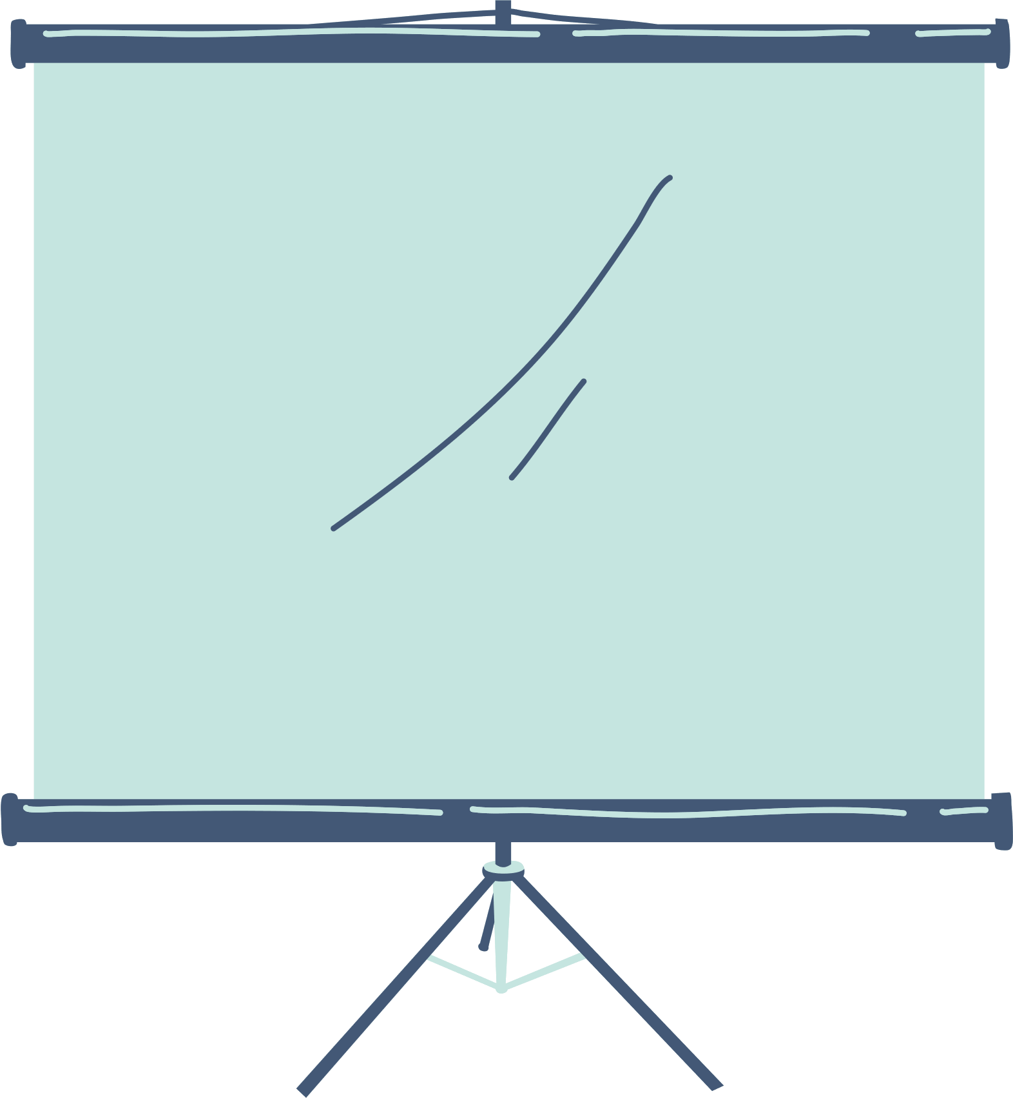
Analysis Plam
About Us
Our Projects
Stats & Numbers
Elaborate on what you want to discuss.
Elaborate on what you want to discuss.
Elaborate on what you want to discuss.

Slide 10

Welcome To Presentation
I'm Rain, and I'll be sharing with you my beautiful ideas.
Follow me at @reallygreatsite to learn more.

Slide 11


Write Your Idea
Briefly elaborate on what you want to discuss.
Briefly elaborate on what you want to discuss.
Briefly elaborate on what you want to discuss.
Briefly elaborate on what you want to discuss.

Slide 12


About Us
Who we are?
Briefly elaborate on what you want to discuss.
What we do?
Briefly elaborate on what you want to discuss.

Slide 13
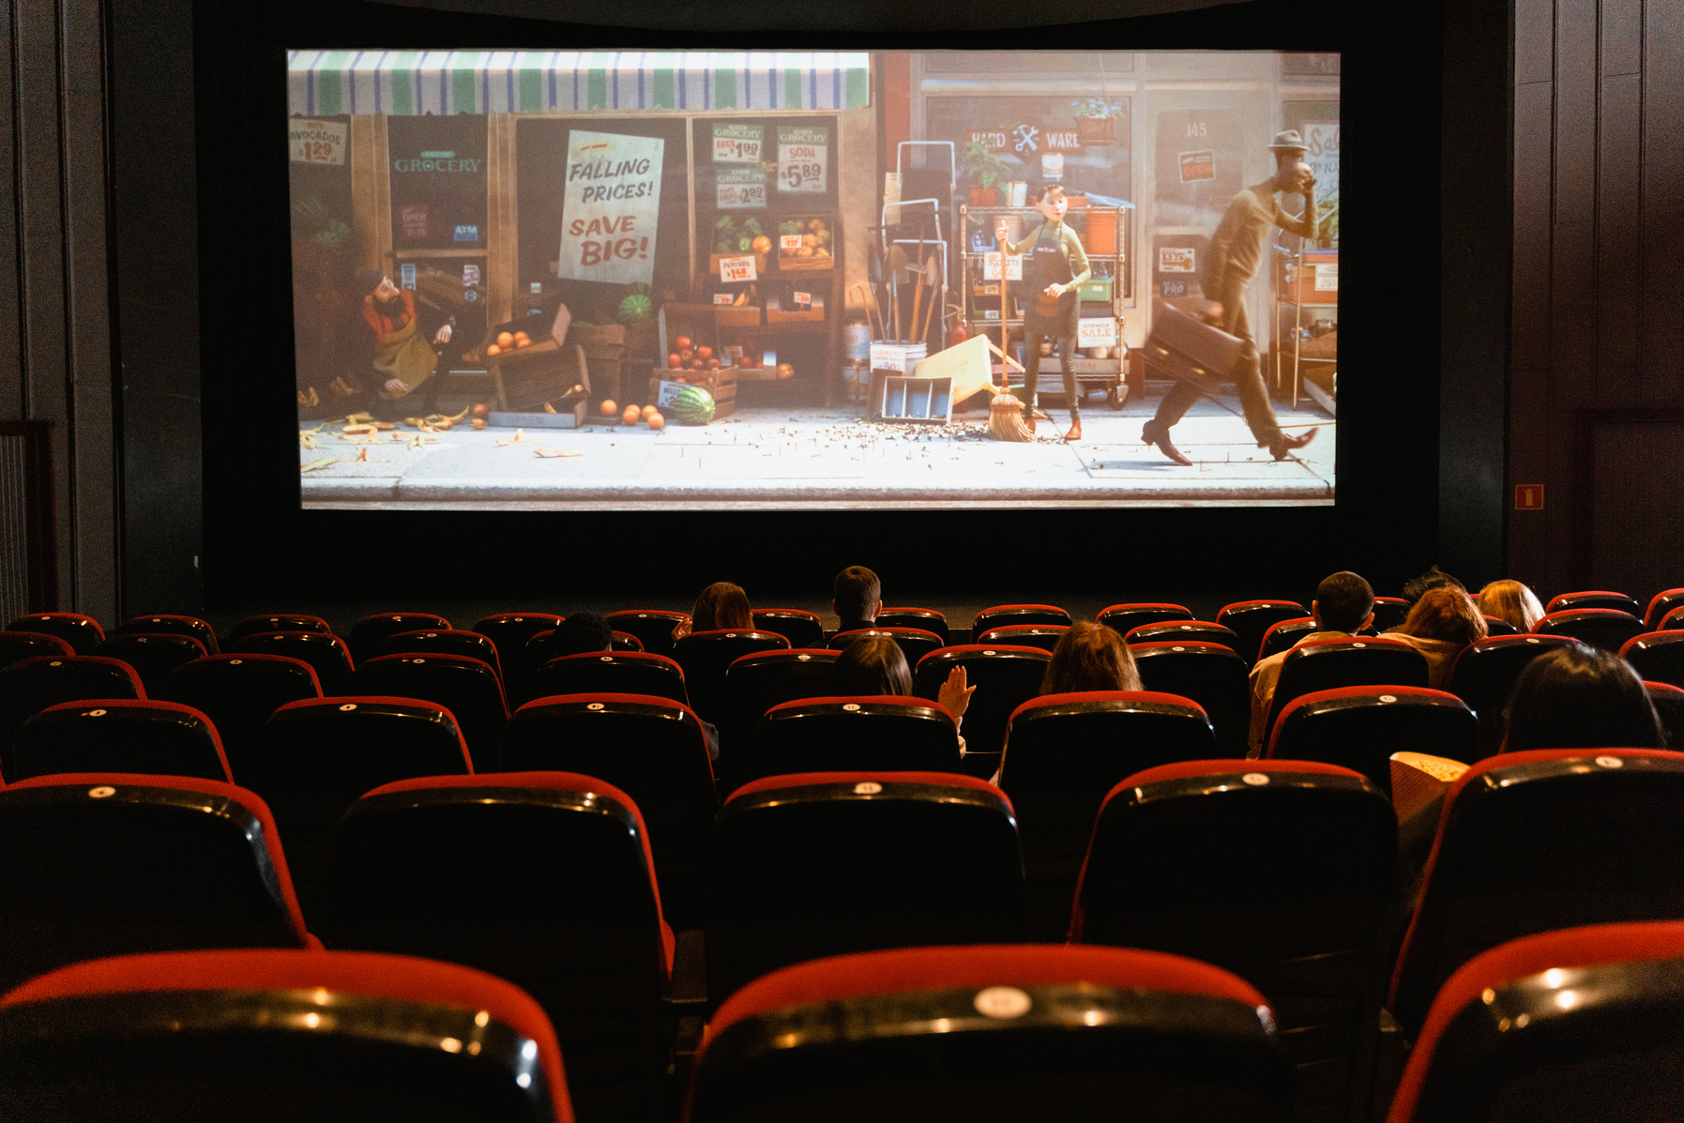


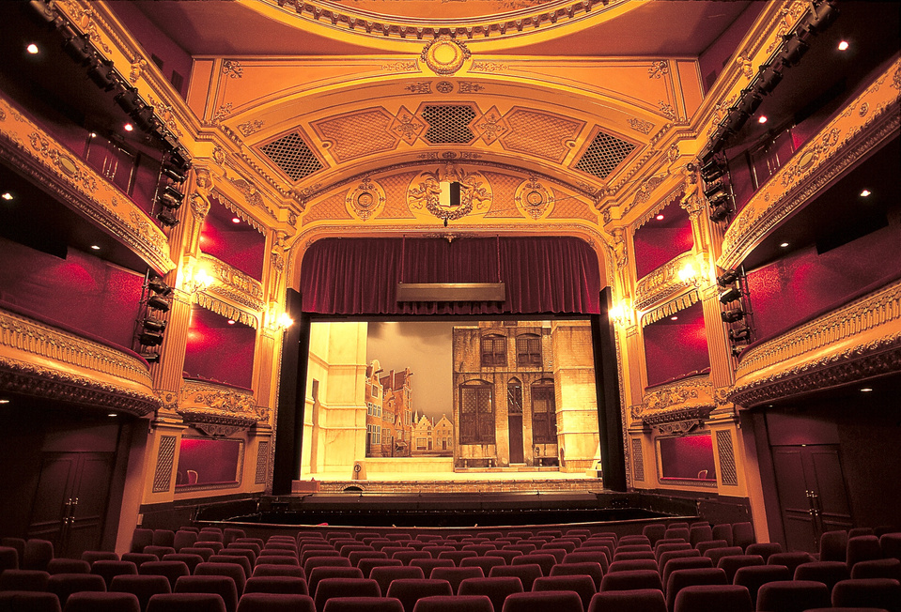


Gallery Image
What can you say about your projects?
Share it here!

Slide 14

Write an original statement or inspiring quote
— Include a credit, citation, or supporting message

Slide 15





Add a Team Members Page
Elaborate on what you want to discuss.
Name
Name
Name
Name
Title or Position
Title or Position
Title or Position
Title or Position

Slide 16


Our Projects
Elaborate on what you want to discuss.

Slide 17

Your Project
Presentations are communication tools that can be used as demonstrations, lectures, speeches, reports, and more. It is mostly presented before an audience. It serves a variety of purposes, making presentations powerful tools for convincing and teaching.
YEAR: 2022
ROLE: WRITE YOUR ROLE

Slide 18

A picture is worth a thousand words

Slide 19


Our Services
Service One
Service Two
Elaborate on what you want
to discuss.
Elaborate on what you want
to discuss.
Service Three
Service Four
Elaborate on what you want
to discuss.
Elaborate on what you want
to discuss.

Slide 20

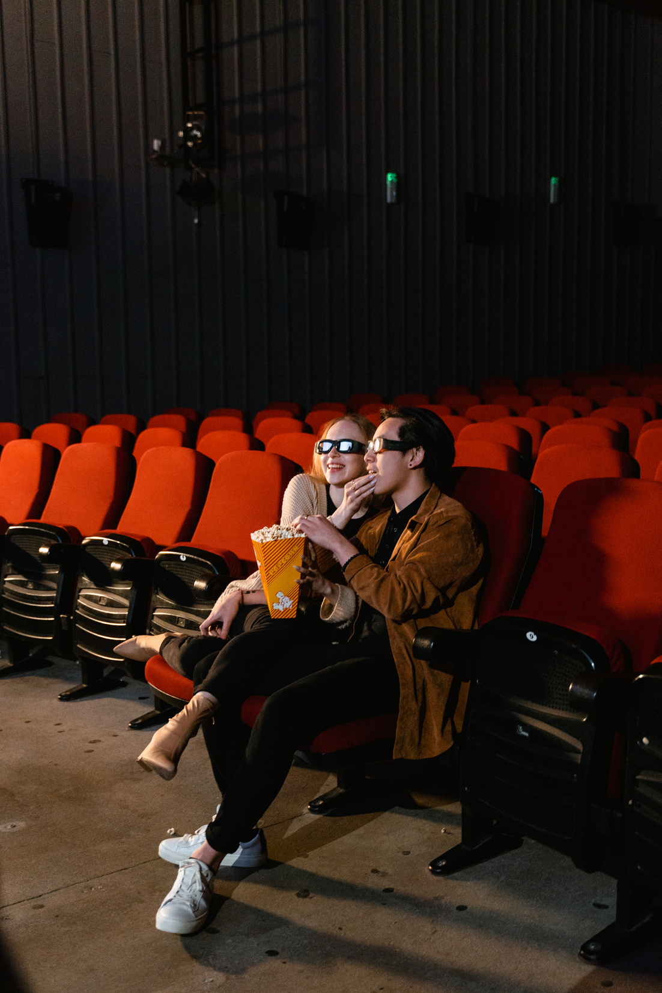
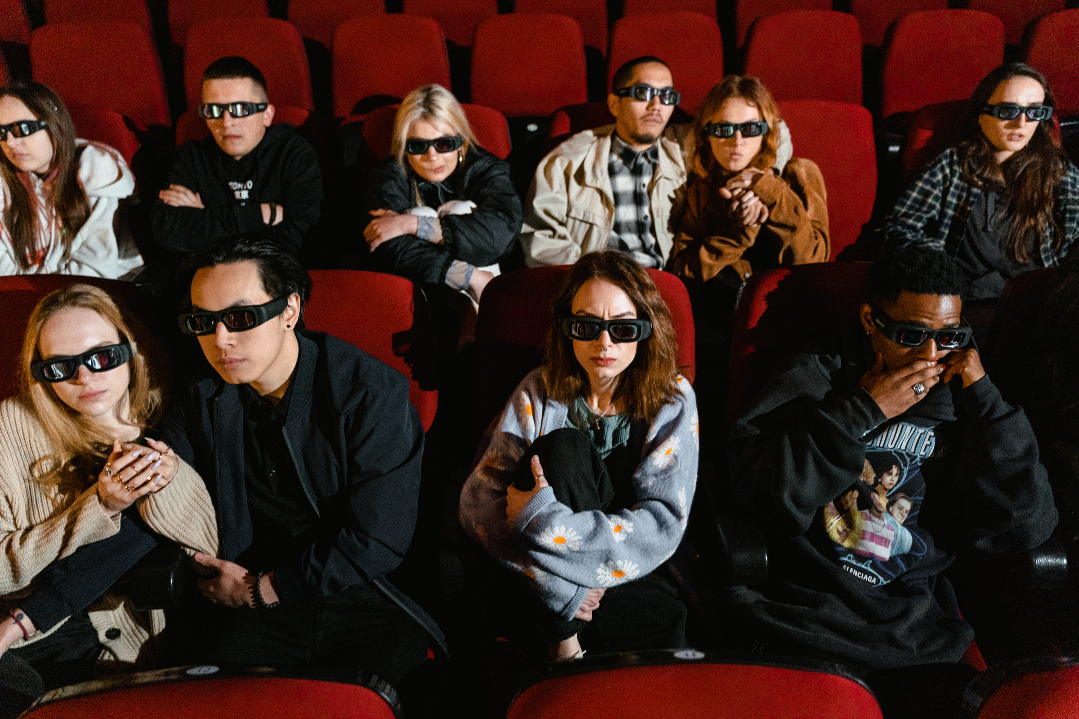
Phone
Mockup
What can you say about your projects? Share it here!

Slide 21
Write Your Big Topic or Idea
Presentations are communication tools that can be used as demonstrations, lectures, speeches, reports, and more.
It serves a variety of purposes, making presentations powerful tools for convincing
and teaching.

Slide 22

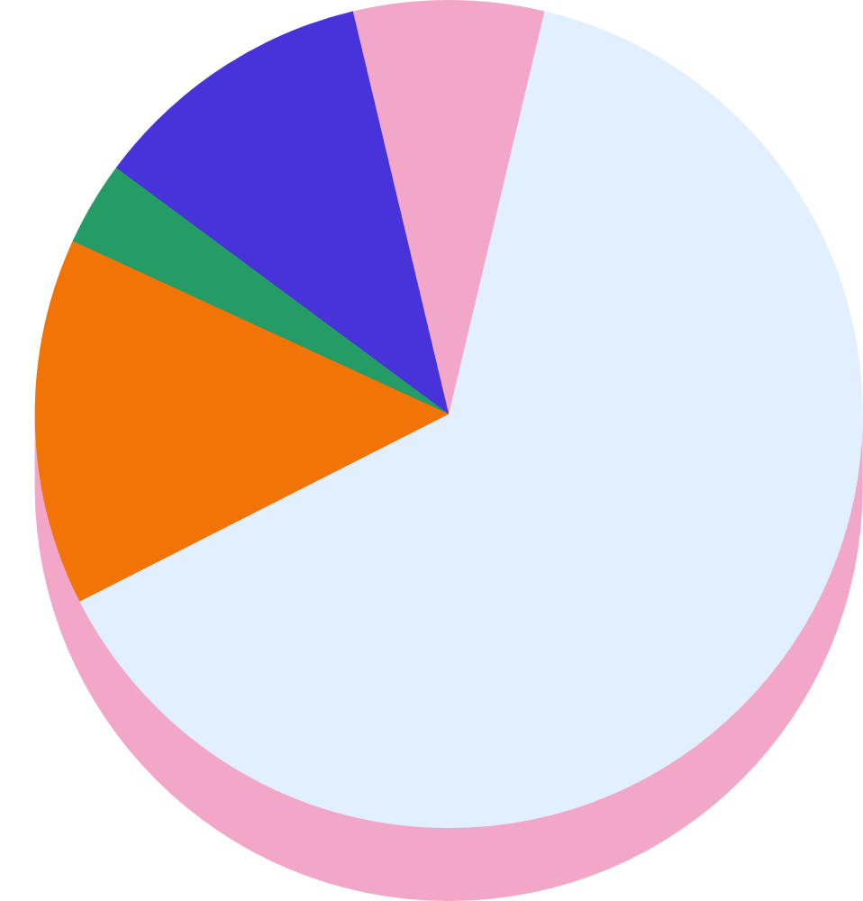

Stats & Numbers
Elaborate on what you want to discuss.

Slide 23

Add a Pricing Page
20$
30$
300$
MONTHLY
MONTHLY
YEARLY
Add a feature
Add a feature
Add a feature
Add a feature
Add a feature
Add a feature
Add a feature
Add a feature
Add a feature
Add a feature
Add a feature
Add a feature

Slide 24

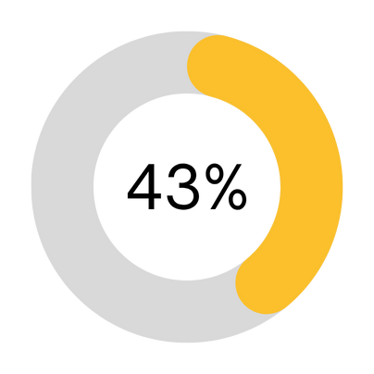

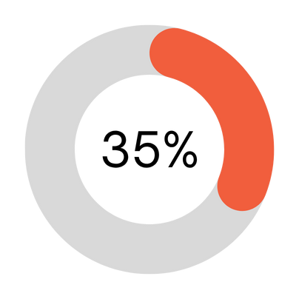

Infographic Slide Report
Elaborate on the featured statistic
Elaborate on the featured statistic.
Elaborate on the featured statistic.
Elaborate on the featured statistic.

Slide 25

S
W
STRENGTHS
WEAKNESSES
What are you doing well?
What sets you apart? What are your good qualities?
Where do you need to improve?
Are resources adequate? What do others do better than you?
O
T
OPPORTUNITIES
THREATS
What are your goals?
Are demands shifting?
How can it be improved?
What are the blockers you're facing?
What are factors outside of your control?

Slide 26






Contact Us
123 Anywhere St., Any City,ST 12345
123-456-7890
hello@reallygreatsite.com
@reallygreatsite
reallygreatsite.com

Slide 27

Credits
This presentation template is free for everyone to
use thanks to the following:
SlidesCarnival for the presentation template
Pexels for the photos
Happy designing!

Slide 28
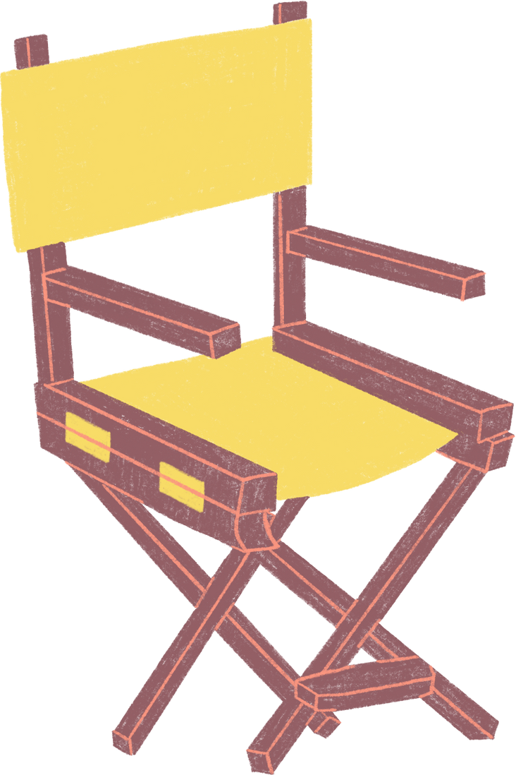
Fonts In this Presentation
This presentation template uses the following free fonts:
Titles: Agrandir black
Headers: Kollektif bold
Body Copy: Kollektif
You can find these fonts online too. Happy designing!

Slide 29

Free templates for all your presentation needs
For PowerPoint, Google Slides, and Canva
100% free for personal or commercial use
Ready to use, professional,
and customizable
Blow your audience away with attractive visuals

Slide 30
Resource
Page
Use these design resources in your Canva Presentation.
Happy designing!
Don't forget to delete this page before presenting.

